Slide 1
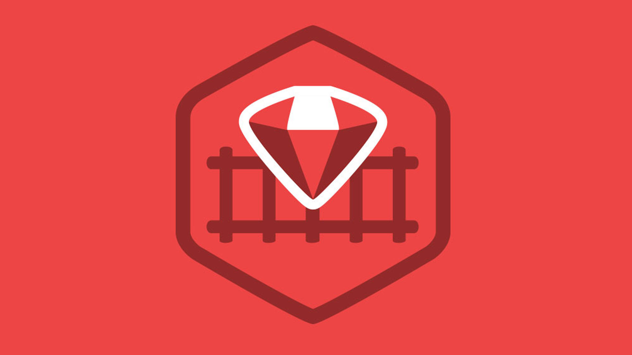
Ruby on Rails

Slide 2
About today…
Ruby on Rails
Creating first app

Slide 3
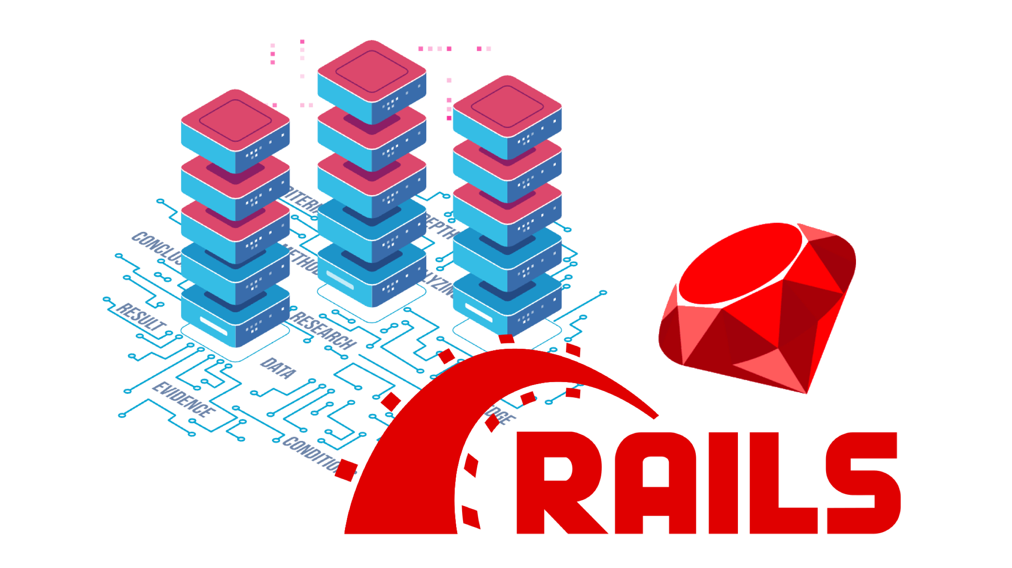
Creating first App

Slide 4

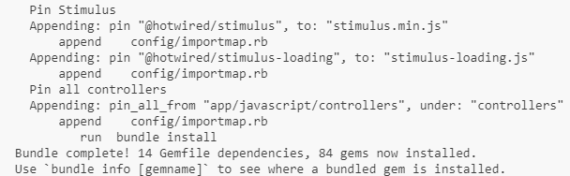
Creating new Rails App
Create a new Rails application
by navigating to the desired directory in your terminal

Slide 5
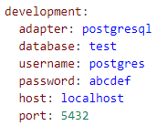
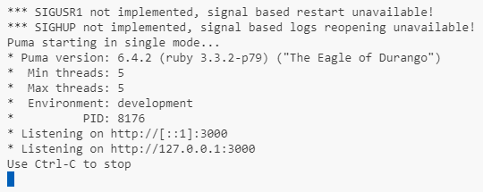
Terminal commands
config/database.yml

Slide 6
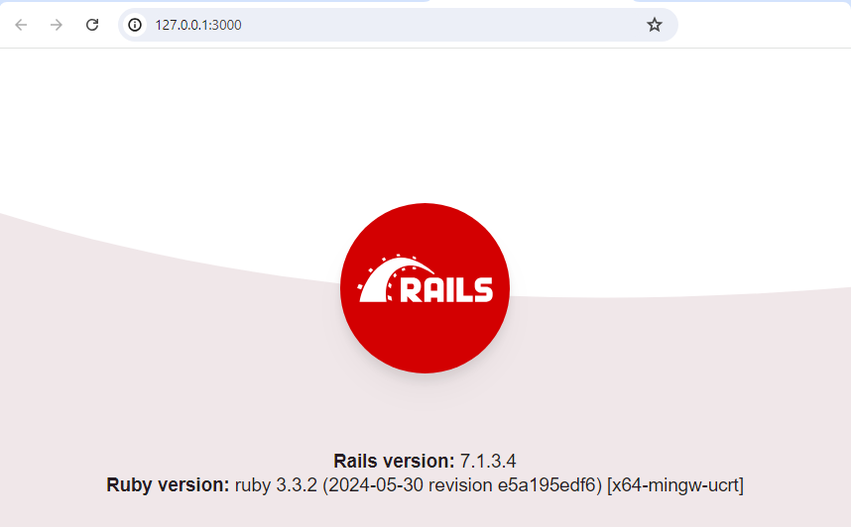
First Interface

Slide 7

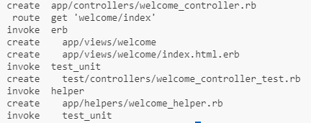

Creating first Controller and View
app/views/welcome/index.html.erb

Slide 8
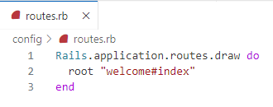
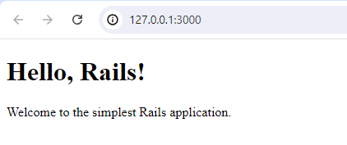
Change default route
config/routes.rb
FIRST APP VIEW

Slide 9


Slide 10

What is the purpose of a controller in a Rails application?
Which command is used to generate a new controller in a Rails application?
What is the default folder where views are stored in a Rails application?
In a Rails controller, how do you define an action named index?
Which file extension is used for HTML view templates in a Rails application?
How do you pass data from a controller to a view in Rails?
How do you specify a route for the index action in the config/routes.rb file?

Slide 11

Task 1
Create a new Rails application by making controller and view of your choice, and show a message by running server

